Slide 1
Predicting Cardiovascular Disease
Presented by TBD
Jada, Trinh, Jingrong, Arshiful, Srijon

Slide 2
Introduction
Cardiovascular diseases are conditions that affect the structures or function of your heart.
According to the World Health Organization, cardiovascular diseases are the number one cause of death globally: more people die annually from cardiovascular diseases than from any other cause.
The most important behavioral risk factors of heart disease and stroke are unhealthy diet, physical inactivity, tobacco use and harmful use of alcohol.

Slide 3
Purpose
Perform different predicting models on the cardiovascular dataset:
Logistic Regression
PCA/PCR
KNN
Decision Tree
Compare the models and find the best model

Slide 4
Description of dataset
The dataset contains 70,000 patient records with 11 features and 1 target. Here is the list of the variables:
Age
Height
Weight
Gender
Systolic blood pressure
Diastolic blood pressure
Cholesterol | 1: normal, 2: above normal, 3: well above normal
Glucose | 1: normal, 2: above normal, 3: well above normal |
Smoking
Alcohol intake
Physical activity
Presence or absence of cardiovascular disease

Slide 5
EDA
6 categorical variables in our dataset: cholesterol, glucose, smoking, alcohol, gender and physical activity
Barplot and χ2 test
χ2 test of independence: cholesterol and glucose
χ2 goodness of fit test: smoking, alcohol, gender and physical activity
5 numeric variables: age, height, weight, systolic blood pressure, diastolic blood pressure
Boxplot and Welch's Two Sample T test (two sided)

Slide 6
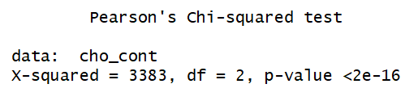
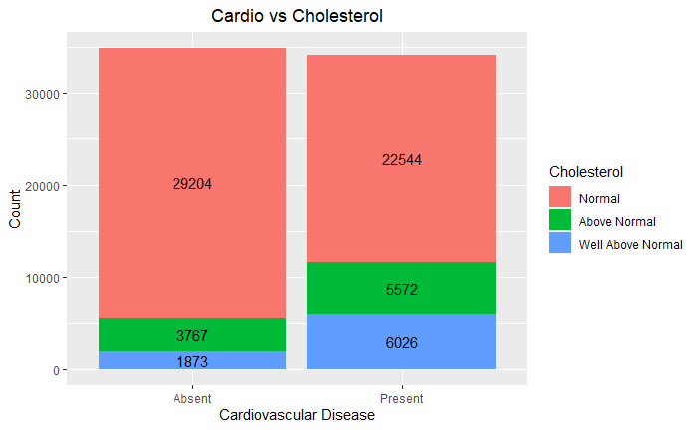
EDA - Cholesterol
Barplot
χ2 test of independence
Result
reject the null hypothesis;
the cholesterol levels do have effects on cardiovascular disease.

Slide 7
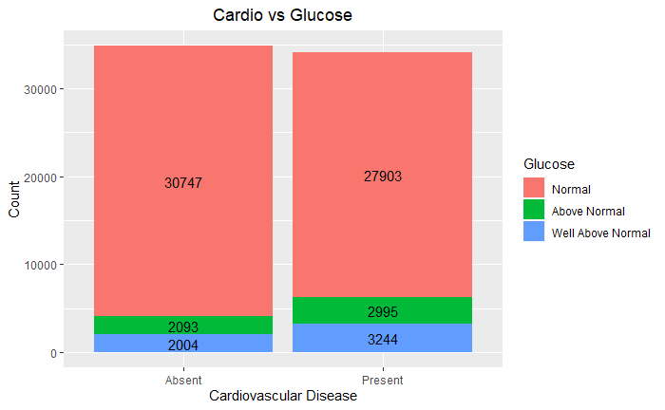
EDA - Glucose
Barplot
Result
perform the same test like cholesterol;
get similar result;
reject the null hypothesis;
the glucose levels do have effects on cardiovascular disease.

Slide 8
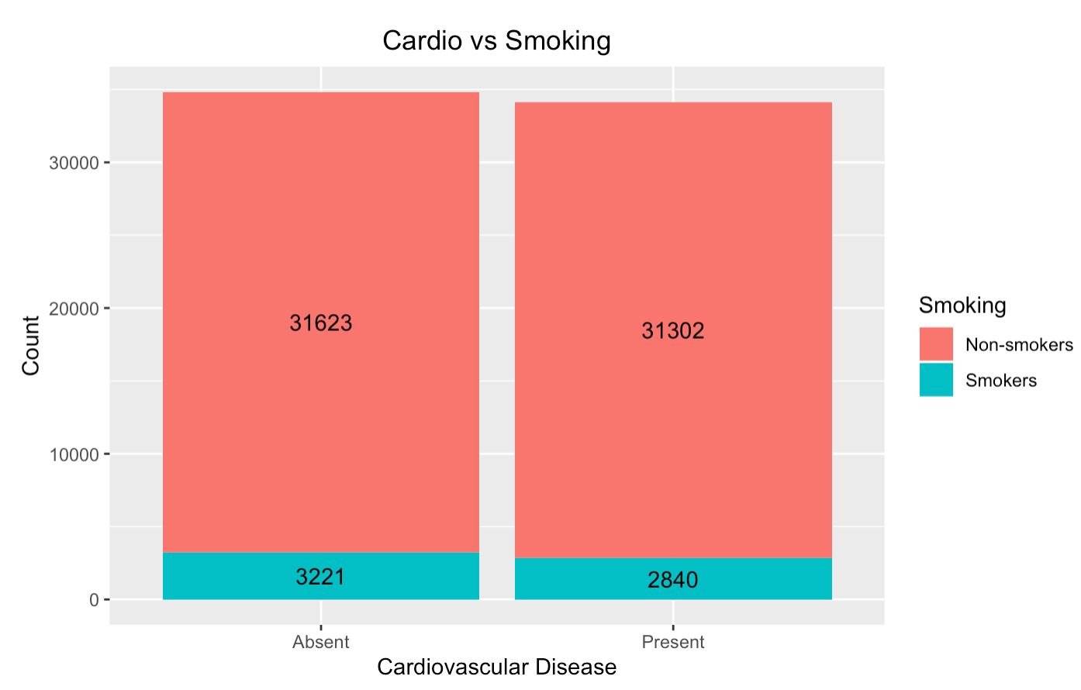
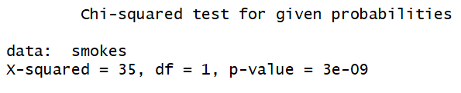
EDA - Smoking
Barplot
χ2 goodness of fit test
Result
reject the null hypothesis;
smoking does have effects on cardiovascular disease.

Slide 9
EDA - Alcohol, Gender and Physical Activity
Result
perform the same test like smoking;
get similar results;
reject the null hypothesis;
alcohol, gender and physical activity do have effects on cardiovascular disease.

Slide 10
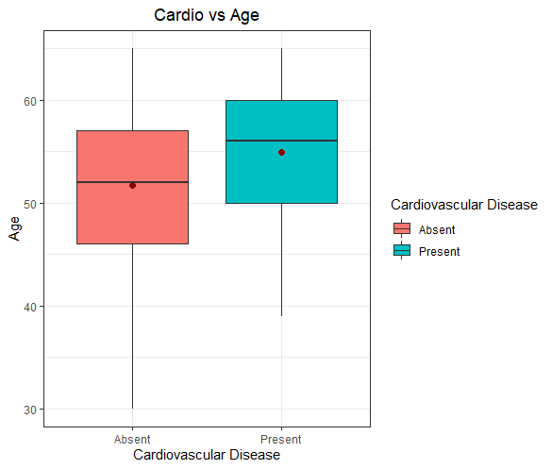
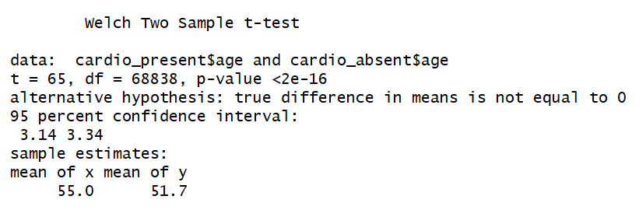
EDA - Age
Boxplot
Two sample t test
Result
reject the null hypothesis;
the average age of two cardio groups is different.

Slide 11
EDA - Height, Weight, Systolic and Diastolic Blood Pressure
Result
perform the same test like smoking;
get similar results;
reject the null hypothesis;
the average height, weight, systolic blood pressure and diastolic blood pressure of two cardio groups is different.

Slide 12
EDA - Summary
Surprisingly, according to the results of the tests, all of the variables in our dataset have effects on the target variable cardio.

Slide 13
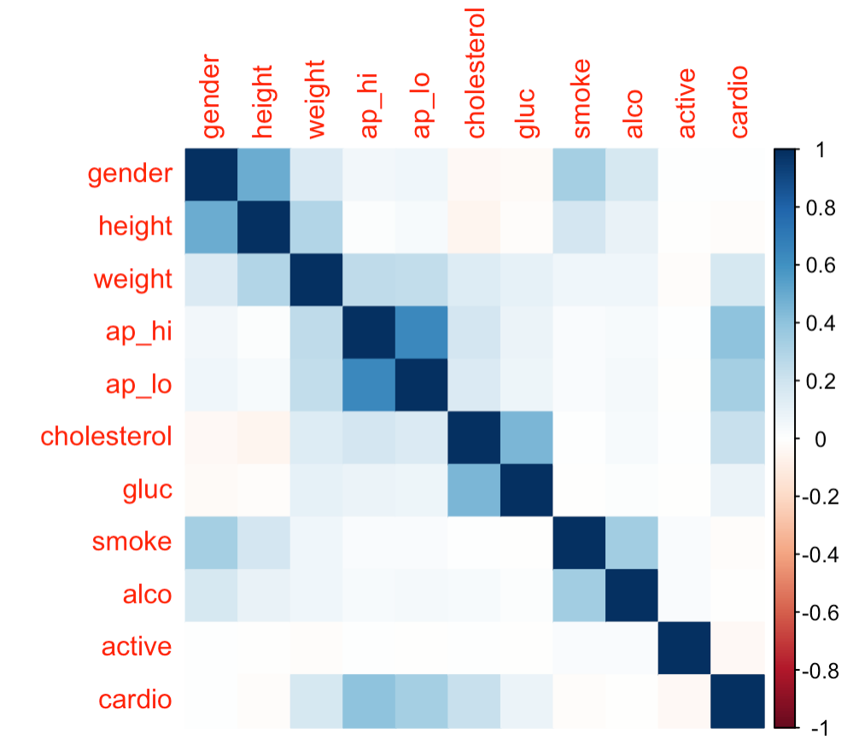
There are a lot of correlations, however none of the variables seem highly correlated.

Slide 14
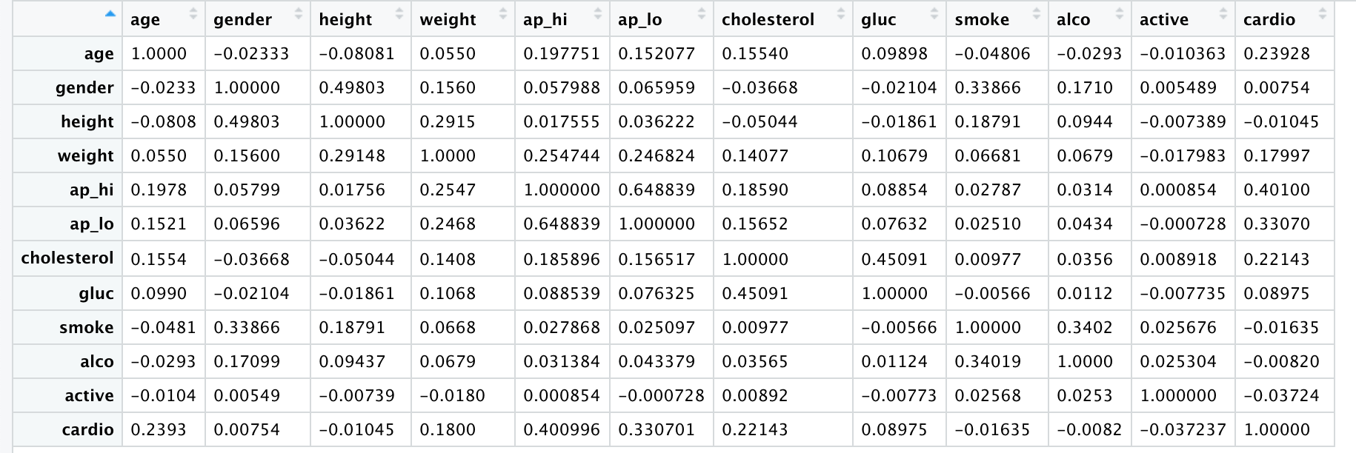
Logistic Regression
I used the correlation matrix to pick the order of predictor variables for the logistic regression model:

Slide 15
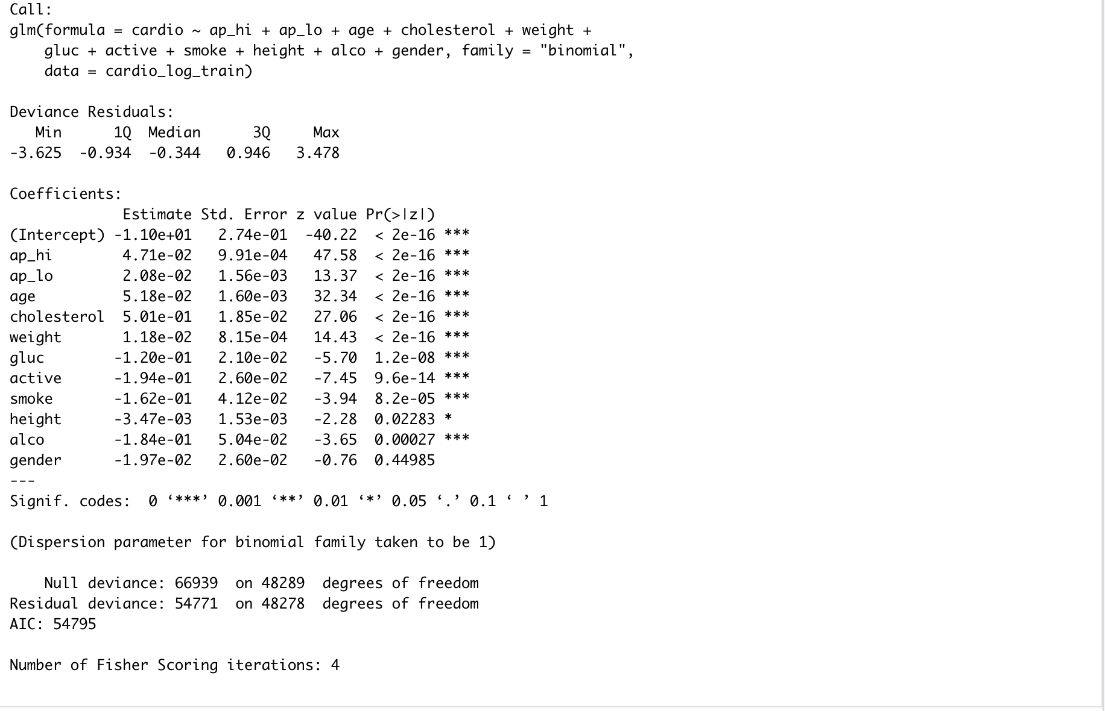
I split the data into two sets (70% split for the training and 30% for test) and made the first fit for the model on the training set using the explanatory variables in order of their absolute correlations:
There is a problem of multicollinearity here.
Possible overfitting
The coefficient for smoking shows a negative value which we can explain by looking at the data - a large number of non-smokers reported cardiovascular disease and being active

Slide 16
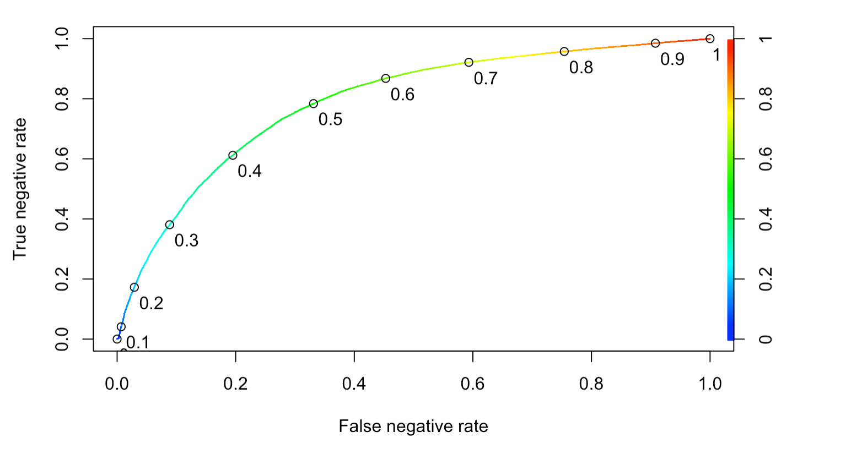
We make a ROC curve to try and decide a threshold value for our model.
The area under the curve is 0.788, which is alright.

Slide 17
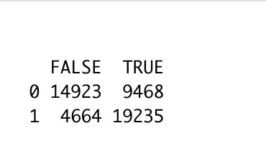
It’s necessary to mention the tradeoff we chose:
In relation to diseases, we want to prevent more false negatives than false positives
We also don’t want to expose patients to strong medication without cause either, so our threshold value shouldn’t be too high.
I decided to go with a threshold value of 0.4 and see how it did predicting for the test data:
So there are a lesser number of False Negatives compared to the False Positives. Great!
I calculated the accuracy from this table, which is coming to 0.708 (70.8%).

Slide 18
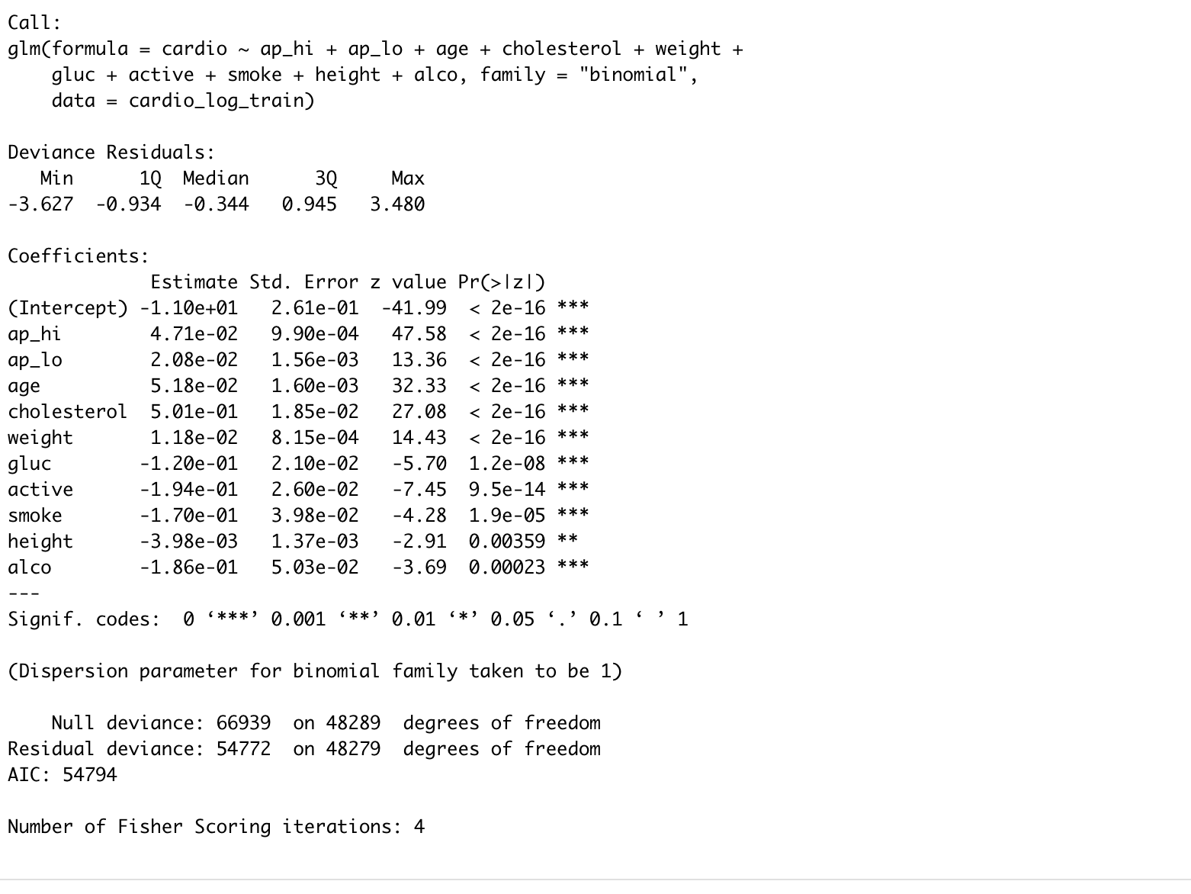
I made another fit, this time removing ‘gender’ since it had a p-value higher than that of the critical value:
Not much seems to change. I made an ROC curve and chose a threshold of 0.4 again. The AUC is still around the same at 0.789.

Slide 19
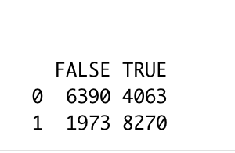
Like I did in the last model, I ran this on the test data and made a table:
The same results. Accuracy is 70.9%.
It’s safe to say that the model won’t perform better than this. I’m gonna try dividing the data into principal components and see if that improves the regression model.

Slide 20
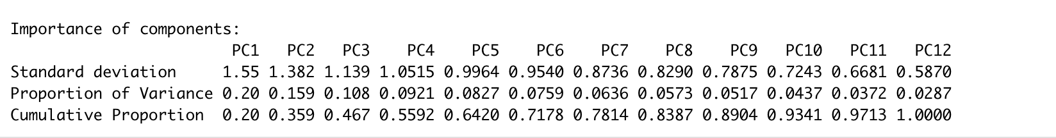
PCR Analysis
I divided the data into principal components:

Slide 21
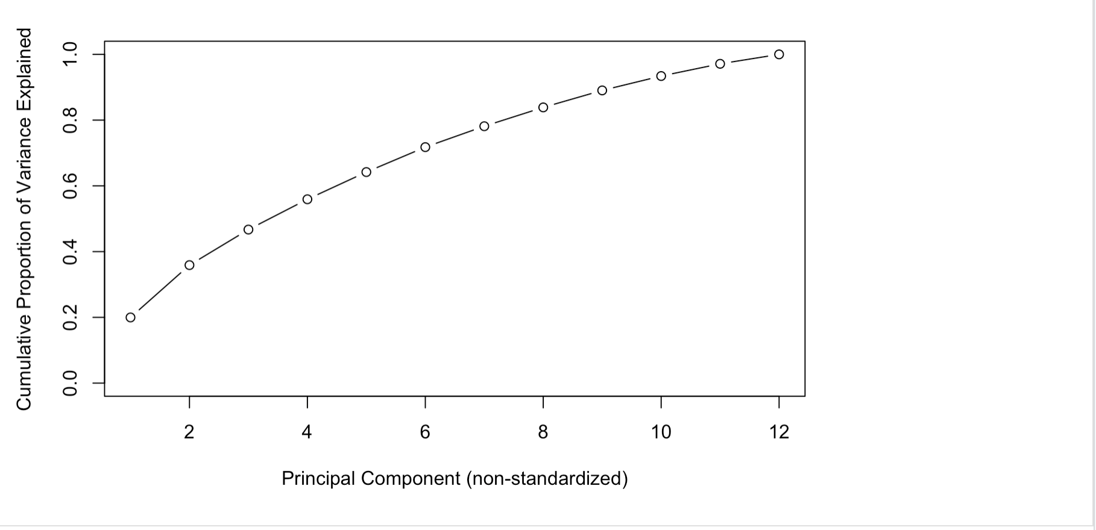
It takes ten principal components to attain 90% of the variance in the data.

Slide 22
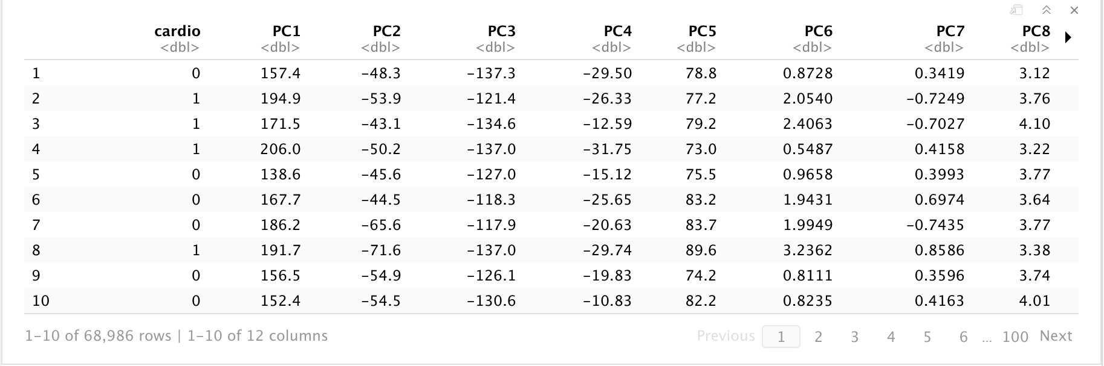
I used the function defined in class to transform the dataset into one with the principal components as feature variables:

Slide 23
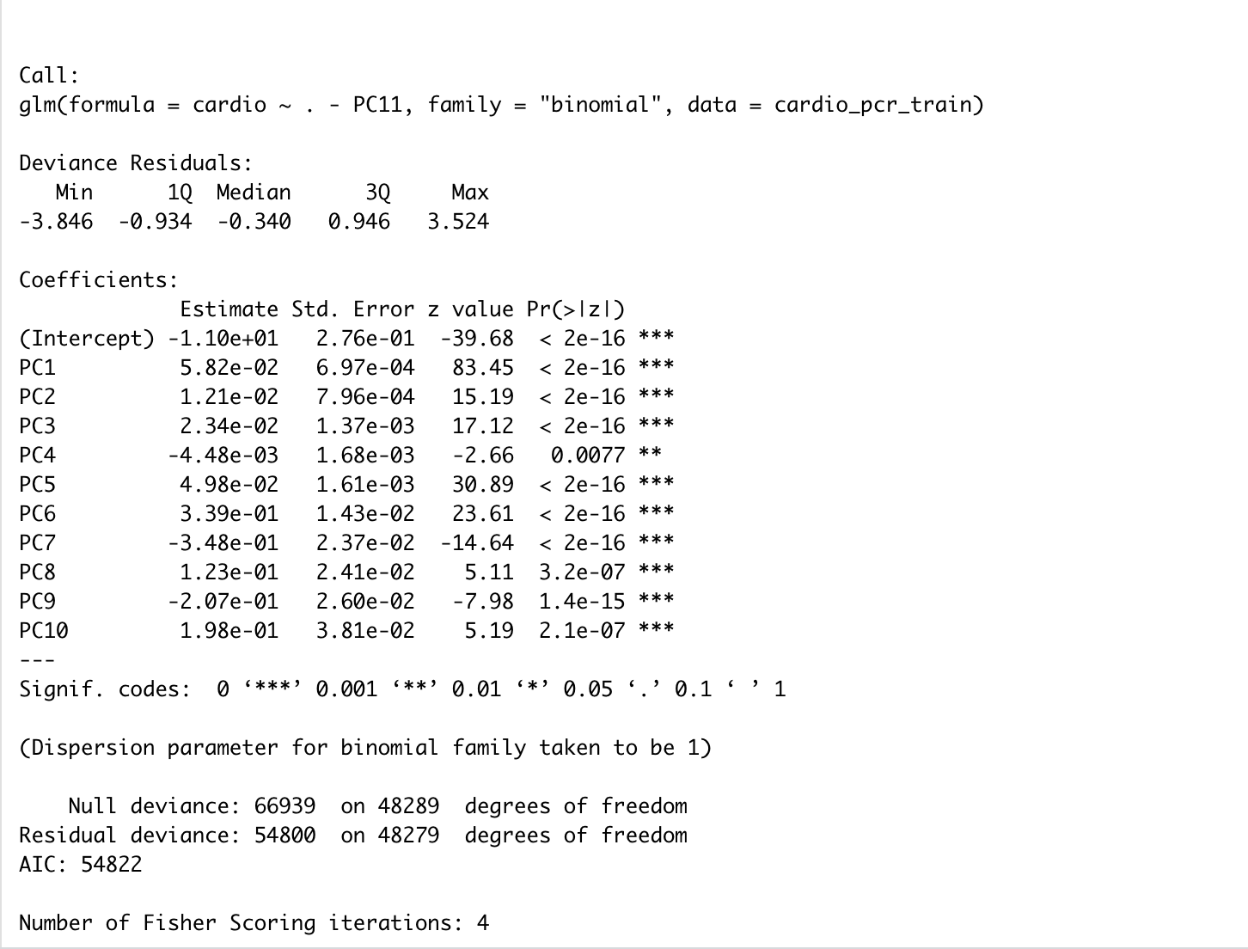
The data was then split into training and test splits in the same 70-30 ratio used for the logistic regression model. A regression model with the ten principal components accounting for 90% of the variance in data was made:

Slide 24
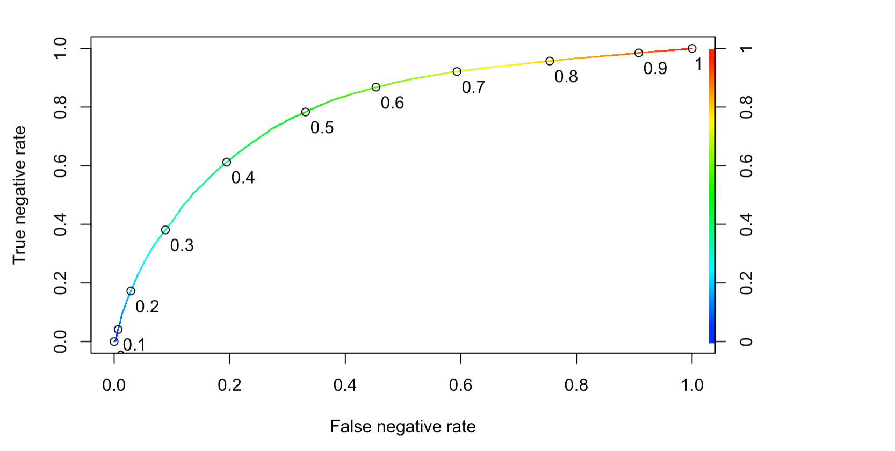
The ROC curve:
The area under the curve hasn’t changed at all. It’s still 0.788.Keeping threshold values same as the Logreg model reduced the number of false negatives by one. The accuracy is now at 0.708, technically a decrease!

Slide 25
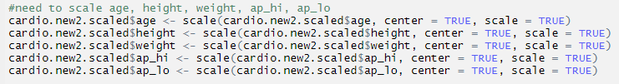
K Nearest Neighbour
Scaled and centered: Age, Height, Weight, Systolic Pressure, Diastolic Pressure

Slide 26
KNN
One hot encoding (OHE) is a process by which categorical variables are converted into a form that could be provided to ML algorithms to do a better job in prediction. So we used OHE to convert cholesterol and glucose to dichotomous variables (1: normal, 2: above normal, 3: well above normal)
cholesterol | cholesterol1 | cholesterol2 | cholesterol3
1 | 1 | 0 | 0
1 | 1 | 0 | 0
2 | 0 | 1 | 0
3 | 0 | 0 | 1
2 | 0 | 1 | 0

Slide 27
KNN
Split data into 70% train set (48,290 rows) and 30% test set (20,696 rows)
Perform KNN for k-values of 3-30 on train set
Apply the model of each k-values on the test set and record the accuracy

Slide 28
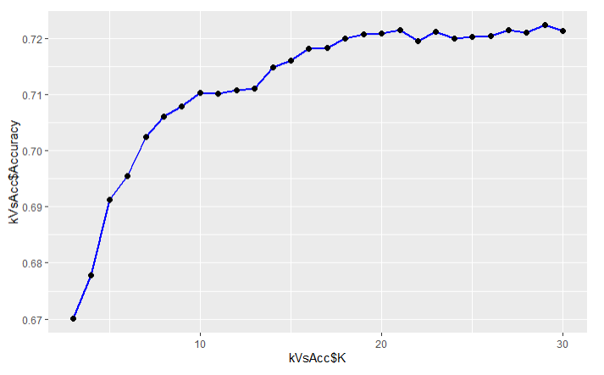
Accuracy against K-value
20-NN seems to be a good choice here, as that shows great improvement in predictive accuracy before the incremental improvement trails off...

Slide 29
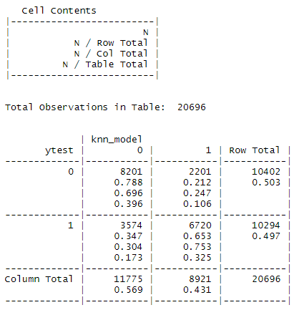
20-NN
Accuracy without OHE = 71.8%
Accuracy = 72.2%
Repeated the whole process but this time with 80:20 split. There was no significant change in accuracy

Slide 30
Decision Tree
Split data into 70% train set (48,290 rows) and 30% test set (20,696 rows)
Perform decision tree on train set
The first split at the root node is based on ap_hi (systolic reading) < 130

Slide 31
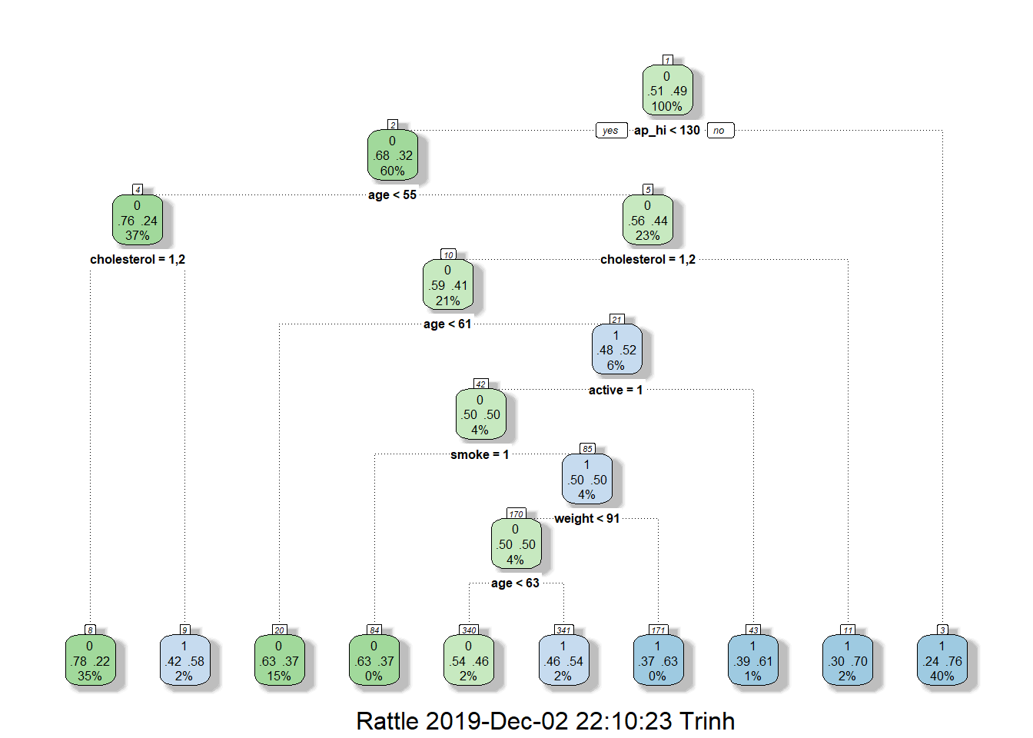
Decision Tree
Classification Tree 1
Variables used: ap_hi, age, cholesterol, active, smoke, and weight
Accuracy: 72.2%

Slide 32
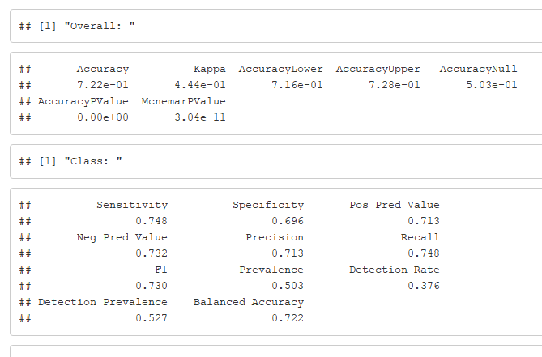
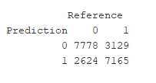
Tree Evaluation

Slide 33
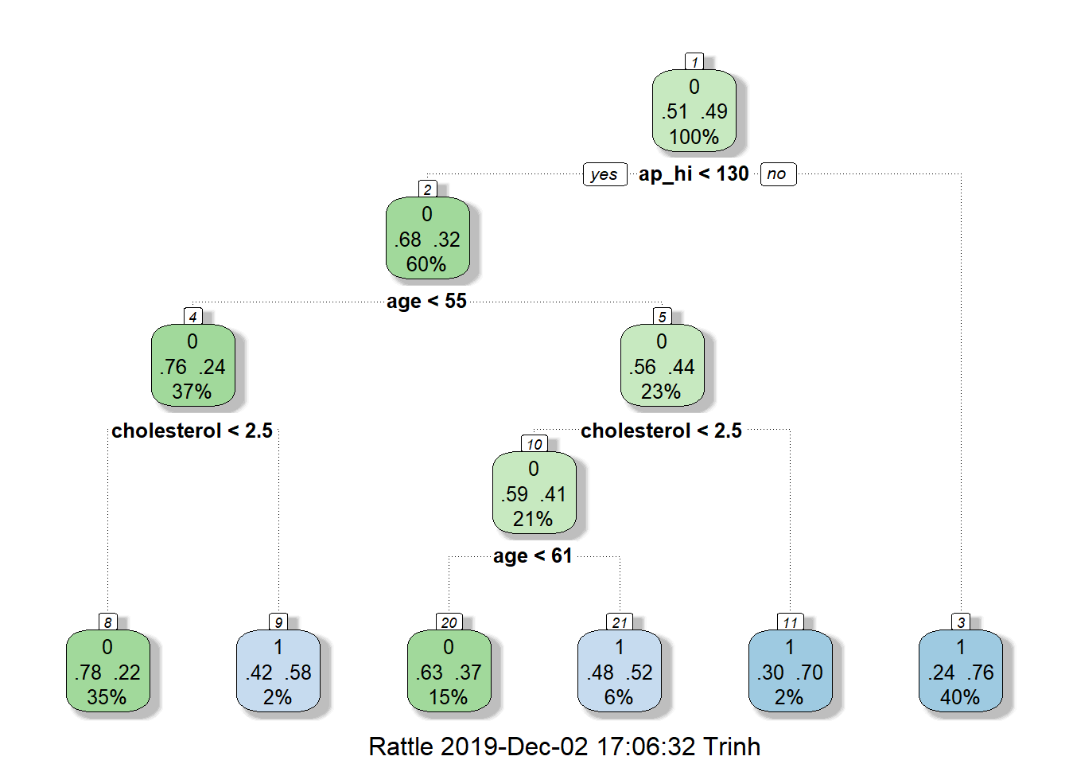
Decision Tree
Classification tree 2
Variables actually used in tree construction: ap_hi, age, and cholesterol
Accuracy: 72.1%

Slide 34
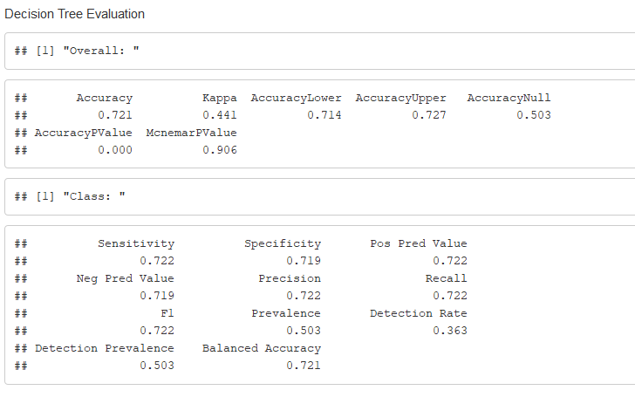

Tree Evaluation

Slide 35
Conclusion
Both KNN and Decision Tree gives 72.2% accuracy, Logistic Regression gives 70.9% accuracy.
KNN and Decision Tree can be used to predict cardiovascular disease.
Blood pressure, age, and cholesterol are the important factors contribute to cardiovascular disease. However, keeping the healthy lifestyle will affect blood pressure and cholesterol and therefore it is important as well.

Slide 36
Reference
https://www.who.int
https://www.cdc.gov/heartdisease/facts.htm
https://www.kaggle.com/sulianova/cardiovascular-disease-dataset

